Slide 1


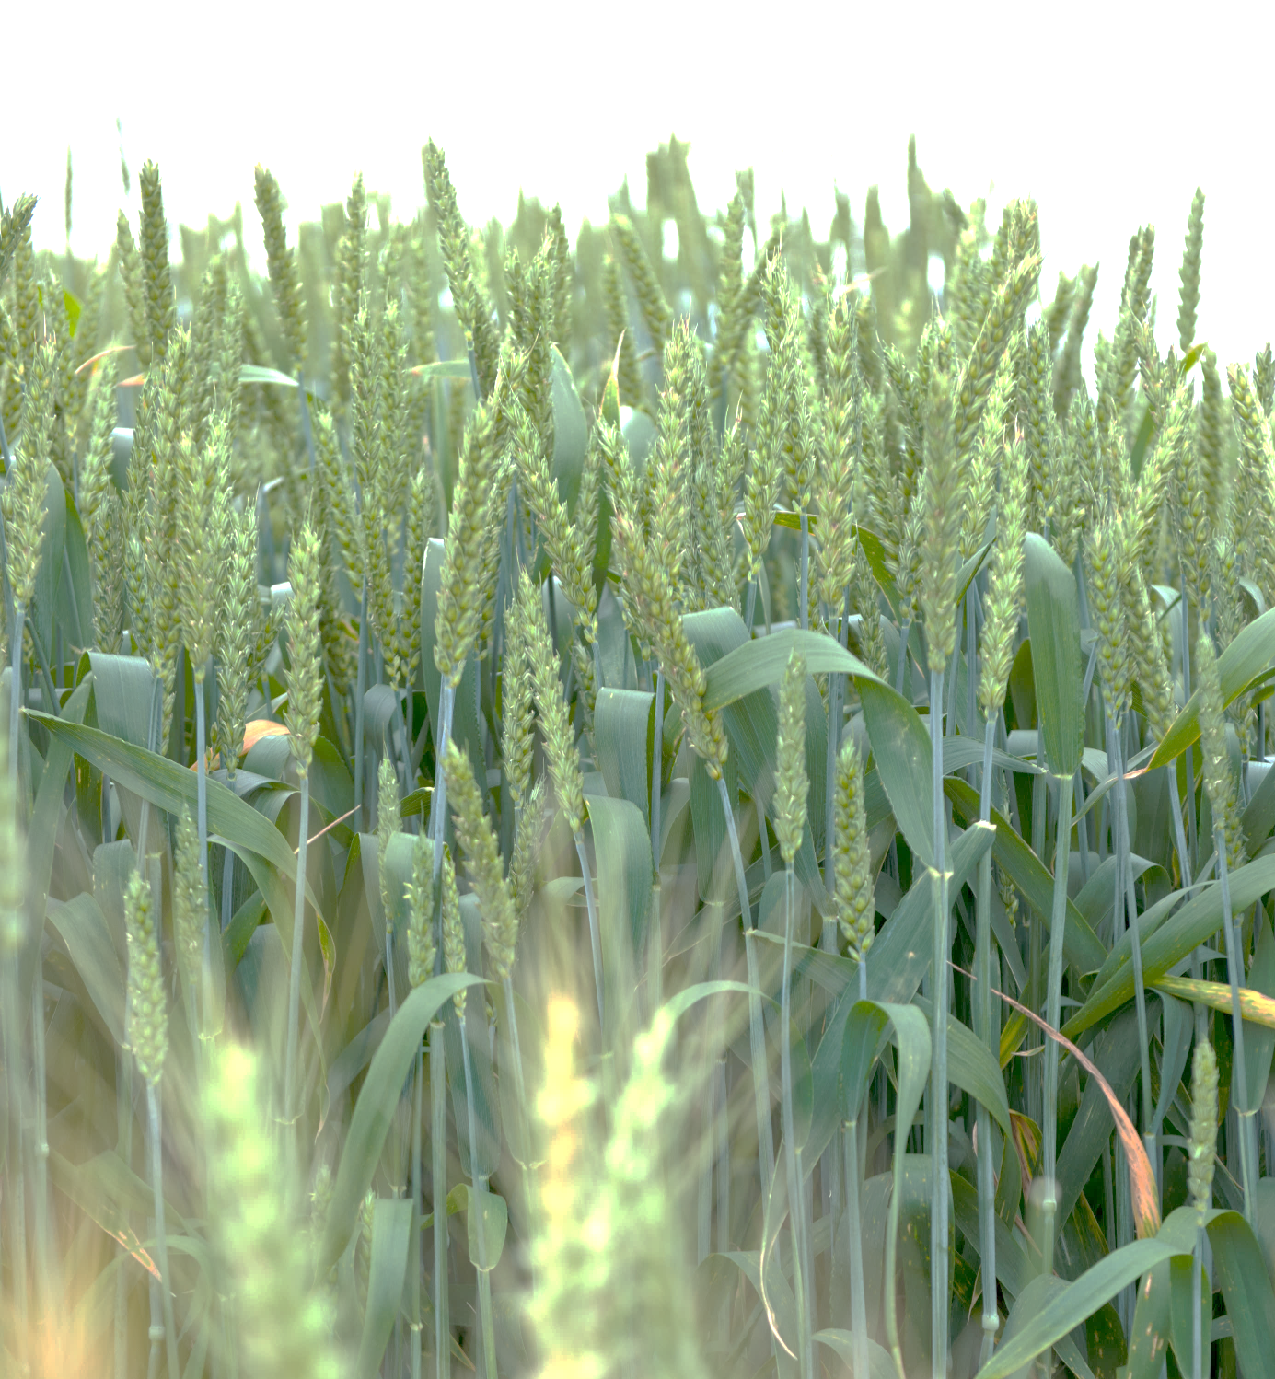
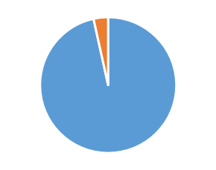
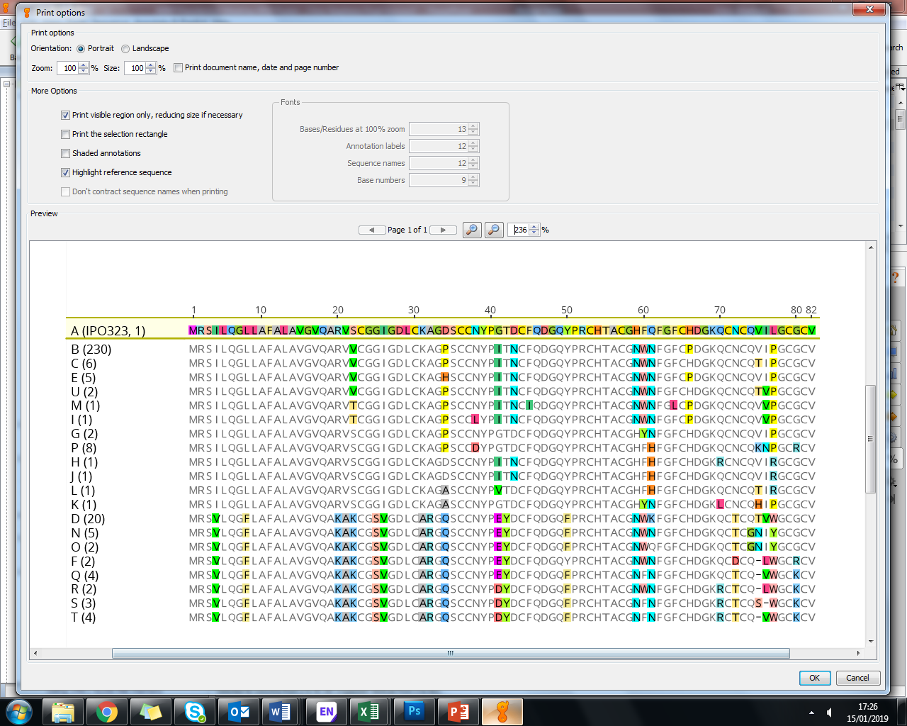
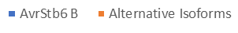
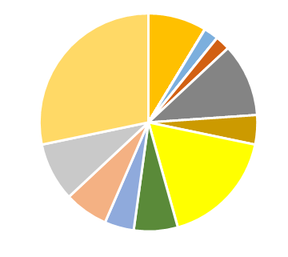
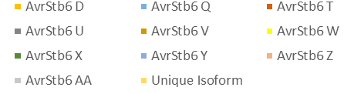



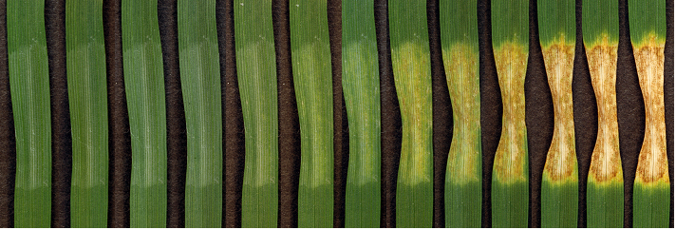
DRAMATIC CHANGES IN GENETIC DIVERSITY OF THE AVIRULENCE EFFECTOR AVRSTB6 IN GLOBAL POPULATIONS OF THE WHEAT PATHOGEN ZYMOSEPTORIA TRITICI
Chris Stephens¹, Hannah Blyth¹, Fatih Ölmez², Megan McDonald³, Peter Solomon³, Andrew Milgate⁴, Hongxin Chen¹, Bart Fraaije¹, Jason Rudd¹ and Kostya Kanyuka¹
1- Rothamsted Research, Harpenden, UK; 2 – Şirnak University, Şirnak, Turkey; 3 - Australian National University, Canberra, Australia; 4 - NSW Department of Primary Industries, Wagga Wagga, Australia
Introduction
Z. tritici, the causal agent of Septoria tritici blotch disease (STB; Fig. 1), is the most commercially important fungal pathogen of wheat in Western Europe, accounting for 70% of fungicide use¹. Many genes conferring resistance to Z. tritici have been discovered in wheat², including Stb6, which confers resistance to isolates possessing the effector gene AvrStb6³. AvrStb6 and Stb6 have both recently been cloned and encode a small, secreted protein⁴ and a wall-associated receptor-like kinase⁵, respectively.
Stb6 is present in wheat used in breeding programs worldwide, possibly imposing selection pressure on AvrStb6. The genetic diversity of AvrStb6 in historic collections of Z. tritici from global populations has been studied, however the prevalence of AvrStb6 haplotypes that allow evasion of Stb6-mediated defence in modern isolates is currently unknown. Here we analysed genetic diversity of AvrStb6 in current Z. tritici field populations from Western Europe, Turkey, USA, South America, and Australia.
Days Post Infection (dpi):
Region | Historic Population | Current Population
Western Europe
USA
Australia
South America
4 6 7 8 9 10 11 12 13 14 16 17 18
n = 131
50%
n = 181
92%
n = 56
0%
n = 52
90%
Figure 1: Progression of typical STB disease symptoms on susceptible wheat, characterised by brown necrotic lesions and asexual fruiting bodies or pycnidia (black speckles), which produce spores that propagate the fungus by rain-splash⁶.
n = 27
74%
n = 58
97%
AvrStb6 Isoforms:
Unknown
n = 30
47%
Figure 3: Prevalence (%) of the isoform B of AvrStb6 in the current and historic^{4, 7} global populations of Z. tritici. n - number of isolates analysed.
Methods
Using a pair of flanking primers we PCR amplified and re-sequenced the AvrStb6 gene from the field isolates of Z. tritici collected between 2014-2017 from different parts of the world.
The AvrStb6 gene and the corresponding protein sequences were aligned using Geneious 10.1.3 aligner to identify haplotypes and protein isoforms and their frequencies in the current and historic^{4, 7} Z. tritici populations.
Figure 2: Alignment of AvrStb6 isoforms identified in current global Z. tritici populations with the reference strain IPO323 isoform. Figures in brackets indicate the number of isolates possessing this isoform.
Results and Future Work
From 372 Z. tritici isolates analysed, 37 isoforms were identified: 21 non-unique AvrStb6 protein isoforms - including those which align with isolates in the “historic” populations - (Fig. 2) and 16 unique isoforms.
Importantly, we show that a single AvrStb6 isoform “B”, conferring virulence towards Stb6 containing wheat, predominates in the current global Z. tritici populations (Fig. 3).
Interestingly, the AvrStb6 haplotype diversity was noticeably higher among Z. tritici isolates from Turkey (Fig. 4) compared to other sampled regions. This could be due to the abundant use of diverse wheat landraces in Turkey, potentially resulting in the increased pathogen diversity.
AvrStb6 haplotypes coding for each dominant protein isoform so far identified will be transformed individually into an engineered ΔavrStb6 mutant strain⁸. Resulting genetic complementation strains will be tested for their ability to infect wheat genotypes with and without Stb6 and perform under different environmental stress conditions.
This will determine which AvrStb6 isoforms evade detection by Stb6, and help pinpoint protein residues that are essential for detection. Moreover, this will help elucidate further the function of AvrStb6 in pathogenicity and assess its potential contribution to fungal fitness.
Figure 4: AvrStb6 Isoform distribution in Turkey Z. tritici population.
Conclusions
We have shown that, whilst current Z. tritici isolates across the globe possess a range of AvrStb6 isoforms, a single isoform conferring virulence on Stb6 wheat predominates. By contrast, the original avirulence isoform found in the reference isolate IPO323 appears to have been eliminated. This study, therefore, revealed a remarkable recent shift in the global Z. tritici populations towards haplotypes encoding a single Stb6 resistance-breaking isoform of AvrStb6.
References
Torriani et al. (2015) Fungal Genetics & Biology 79, 8-12
Brown et al. (2015) Fungal Genetics & Biology 79, 33-41
Brading et al. (2002) Phytopathology 92, 439-445
Zhong et al. (2017) New Phytologist 214, 619-631
Saintenac et al (2018) Nature Genetics 50, 368–374
Keon et al. (2007); MPMI; 20, 178-193
Brunner & McDonald (2018) Molecular Plant Pathology 19, 1836-1846
Kema et al. (2018) Nature Genetics 50, 375-380
Acknowledgments:
This project was funded by the University of Nottingham-Rothamsted BBSRC Doctoral Training Partnership.

